Slide 1
学业综合汇报
2017-2018学年
汇报人：阚晓立
导 师：陈志立教授

Slide 2
报告内容
1、基础课程学习
2、研究方向情况
3、今后工作规划

Slide 3
01
基础课程学习
组合数学
算法设计与分析
高级计算机网络
可证明安全理论
分组密码的设计与分析
大数据技术原理与应用
机器学习
计算机专业英语

Slide 4
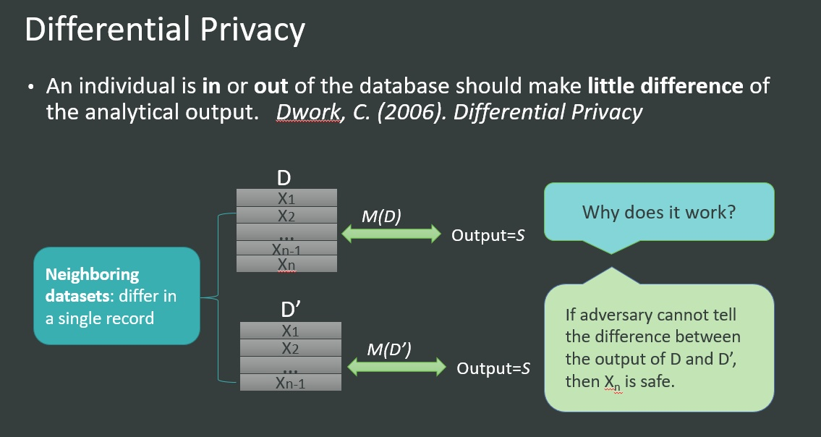
02
研究方向情况
研究方向
定义:设有随机算法 ， 为 算法 所有可能的输出构成的集合。对于任意两个邻近数据集 和 (数据集间只相差一条记录)，若算法 满足：
差分隐私

Slide 5
02
研究方向情况
2006年
2012年
2015年
2015年
2017年
C.Dwork首次提出了差分隐私，在发布整体信息的同时可以保护个人隐私
Andrés M E, Bordenabe N E, Chatzikokolakis K提出了利用差分隐私，在发布单个位置点的同时保护个人隐私
He X, Cormode G, Machanavajjhala A提出了对于不同时空分辨率率下利用差分隐私保护用户的轨迹信息
H.Li, L.Xiong, X. Jiang, and J.Liu提出对于动态数据集发布时，利用差分隐私自适应采样发布数据的方法
Xu F, Tu Z, Li Y提出了一种针对基于移动基站发布用户的聚合数据并不能保护用户轨迹隐私的攻击模型
[1] C. Dwork, “Differential privacy,” in ICALP’06, 2006
[2] Andrés M E, Bordenabe N E, Chatzikokolakis K, et al. Geo-indistinguishability: differential privacy for location-based systems[J]. Corr, 2012:901-914.
[3]He X, Cormode G, Machanavajjhala A, et al. DPT: differentially private trajectory synthesis using hierarchical reference systems[J]. Proceedings of the Vldb Endowment, 2015, 8(11):1154-1165.
[4]H. Li, L. Xiong, X. Jiang, and J. Liu. Differentially private histogram publication for dynamic datasets: an adaptive sampling approach. In CIKM, pages 1001–1010, 2015.
[5]Xu F, Tu Z, Li Y, et al. Trajectory Recovery From Ash: User Privacy Is NOT Preserved in Aggregated Mobility Data[C]// International Conference on World Wide Web. International World Wide Web Conferences Steering Committee, 2017:1241-1250.

Slide 6
02
论文学习情况
[1]Li N, Min L, Su D, et al. Differential Privacy:From Theory to Practice[J]. Synthesis Lectures on Information Security Privacy & Trust, 2016, 8(4):138.
[2]Fan L, Xiong L. An Adaptive Approach to Real-Time Aggregate Monitoring with Differential Privacy[J]. IEEE Transactions on Knowledge & Data Engineering, 2014, 26(9):1-1.
[3]Tu Z, Zhao K, Xu F, et al. Beyond K-Anonymity: Protect Your Trajectory from Semantic Attack[C]// IEEE International Conference on Sensing, Communication, and NETWORKING. IEEE, 2017:1-9.
[4]Kellaris G, Papadopoulos S, Xiao X, et al. Differentially private event sequences over infinite streams[J]. Proceedings of the Vldb Endowment, 2014, 7(12):1155-1166.
[5]Andrés M E, Bordenabe N E, Chatzikokolakis K, et al. Geo-indistinguishability: differential privacy for location-based systems[J]. Corr, 2012:901-914.
[6]He X, Cormode G, Machanavajjhala A, et al. DPT: differentially private trajectory synthesis using hierarchical reference systems[J]. Proceedings of the Vldb Endowment, 2015, 8(11):1154-1165.
[7]]H. Li, L. Xiong, X. Jiang, and J. Liu. Differentially private histogram publication for dynamic datasets: an adaptive sampling approach. In CIKM, pages 1001–1010, 2015.
[8]Xu F, Tu Z, Li Y, et al. Trajectory Recovery From Ash: User Privacy Is NOT Preserved in Aggregated Mobility Data[C]// International Conference on World Wide Web. International World Wide Web Conferences Steering Committee, 2017:1241-1250.
[9]Xu J, Zhang Z, Xiao X, et al. Differentially private histogram publication[J]. Vldb Journal, 2013, 22(6):797-822.
[10]Zhang Y, Mao Y, Zhong S. Joint Differentially Private Gale–Shapley Mechanisms for Location Privacy Protection in Mobile Traffic Offloading Systems[M]. IEEE Press, 2016.
[11]Liu C, Chakraborty S, Mittal P. Dependence Makes You Vulnerable: Differential Privacy Under Dependent Tuples[C]// Network and Distributed System Security Symposium. 2016.

Slide 7
03
今后工作规划
总结：
1.阅读了与自己的研究方向相关的相关文献，对差分隐私和位置轨迹数据的 发布有了大致的了解；
2.已有一篇关于差分隐私机制下保护用户轨迹的专利
3.正在写一篇利用差分隐私机制去保护移动基站数据的发布的文章。
展望：
1.进一步完善实验代码，完成论文的编写；
2.继续阅读相关的优秀文献，更加深入的了解差分隐私在机制设计中的应用。

Slide 8
Thank you

